Slide 1
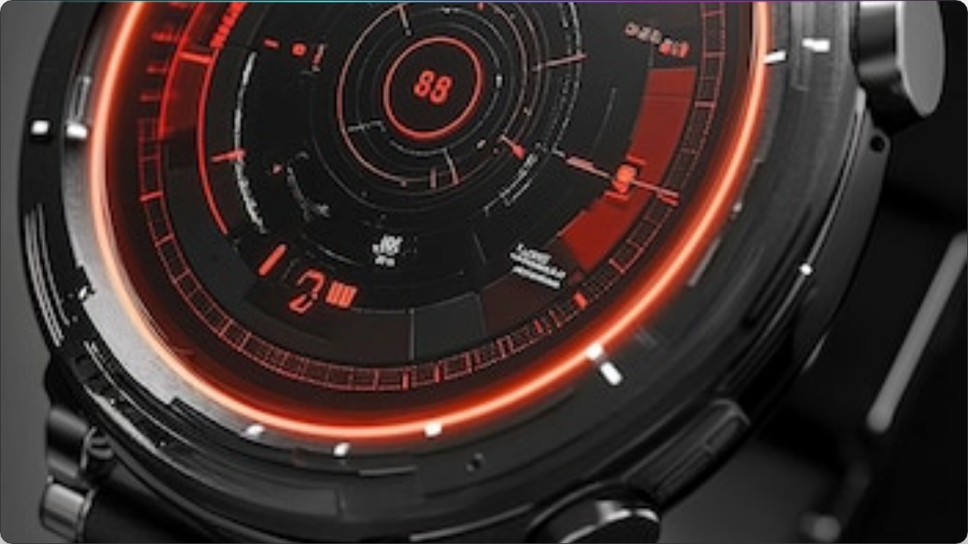

SMARTWATCH SENTIMENT ANALYZER
Uncovering Customer Sentiments for ABC X1
A Mini Project Using Streamlit & TextBlob
SRM University – 2025

Slide 2


PROJECT TEAM
GROUP MEMBERS
GUIDED BY
Sriram Revanth Sai
Shiva sir
B. Rohith
Aravind sir
Madhan Reddy
Surya sir
Chaitanya
G. Nitesh Kumar
SRM University

Slide 3

PROBLEM & OBJECTIVES
THE CHALLENGE
Companies receive thousands of product reviews online. Manually reading and analyzing customer feedback for the ABC X1 Smartwatch is time-consuming and prone to human error.
OUR OBJECTIVES
Automate sentiment classification (Positive, Negative, Neutral).
Develop a user-friendly Streamlit tool.
Provide instant insights for quality improvement.
Demonstrate NLP in real-world applications.

Slide 4
SOLUTION WORKFLOW
4. OUTPUT
2. PREPROCESSING
Sentiment Label & Score displayed instantly.
Text cleaning & tokenization.
1. USER INPUT
3. ANALYSIS
Customer review entered via Streamlit UI.
TextBlob calculates Polarity & Subjectivity.

Slide 5


DATASET & METHODOLOGY
DATASET
No external dataset required. Real-time user input is processed dynamically via the application interface.
METHODOLOGY (RULE-BASED)
TextBlob computes a polarity score between -1.0 and 1.0.
// Classification Logic

Slide 6






TECHNOLOGIES STACK
PYTHON
STREAMLIT
TEXTBLOB
Core programming language used for logic and NLP processing.
Framework for creating the interactive web-based user interface.
NLP library used for calculating sentiment polarity and subjectivity.

Slide 7

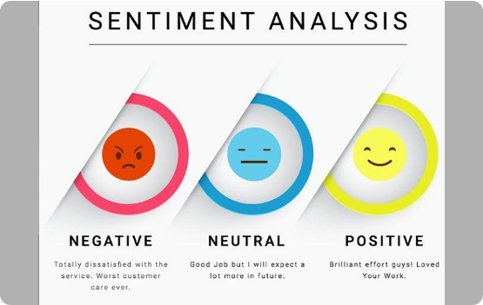
RESULTS & FINDINGS
PERFORMANCE
The tool accurately identifies sentiment in short smartwatch reviews, providing instant numerical feedback.
EXAMPLE OUTPUT:
"This is a very nice watch"
➔ Positive Sentiment (Polarity: 0.8)
KEY FINDINGS
TextBlob performs exceptionally well on direct, short feedback.
Real-time analysis allows immediate customer satisfaction tracking.
Mixed-opinion reviews show moderate polarity scores (e.g., +0.3).

Slide 8
CONCLUSION & FUTURE SCOPE
CONCLUSION
FUTURE SCOPE
We successfully developed a simple, interactive Smartwatch Sentiment Analyzer.
To enhance the system, we plan to implement:
Integration with live e-commerce APIs (Amazon/Flipkart).
Provides fast and reliable classification.
Helps ABC Company understand customer opinions effectively.
Advanced Transformer models like BERT or VADER.
Multilingual support for global reviews.
Demonstrates the power of Python in NLP.
Mobile app version for on-the-go analysis.

Slide 9




IMAGE SOURCES
https://pikwizard.com/pw/medium/698e6ec9d1205d0194163aa88f46d85e.jpg
Source: pikwizard.com
https://www.red-gate.com/simple-talk/wp-content/uploads/2022/02/graphical-user-interface-text-application-descr-2.png
Source: www.red-gate.com
https://miro.medium.com/1*jHzNpL-KagnaHUSHzPTPkA.jpeg
Source: medium.com
https://img.freepik.com/premium-photo/futuristic-smartwatch-sleek-interface-glowing-screen-dark-background_1342292-8186.jpg
Source: www.freepik.com

